Slide 1
[Computer Architecture Fundamentals and Concepts]
[Computer Architecture and Operating Systems]
Lecture [10]
[Security in Operating Systems]
This lecture and its associated materials have been produced by [Bikash Bhattarai and MBA] of iAcademy for the purposes of lecturing on the above described subject and the material should be viewed in this context. The work does not constitute professional advice and no warranties are made regarding the information presented. The Author and iAcademy do not accept any liability for the consequences of any action taken as a result of the work or any recommendations made or inferred. Permission to use any of these materials must be first granted by iAcademy.

Slide 2
Agenda
Week 10 Lecture Coverage
  Key concepts security in operating systems
  Program threats
  System and network threats
  Host based firewalls and Network based firewalls

Slide 3
Learning Objectives
On successful completion of this lecture, students will be able to demonstrate:
  Understand security issues in modern operating system
  Understand virus, spyware, firewalls

Slide 4
Review of Week 9 (1)
From last week we should have understood:
  Server operating system
  Desktop operating system
  Functions of server operating system
  Functions of desktop operating system

Slide 5
Review of Week 9 (2)
Give some services provided by servers?
  (Directory services, DNS, FTP server, HTTP server, Email server, Proxy server, database server)
What are the major differences between server and desktop operating system?
(numbers of connections, memory, CPSs', network optimization, redundancy)

Slide 6

Q&A ?
Coursework Submission

Slide 7
Security in Operating System
Computer security mainly focus on 3 points
To prevent theft or damage to the hardware
To prevent theft or damage to the information
To prevent disruption of service

Slide 8
Security in Operating System
The security problem
  employees
  Intruders (crackers) attempt to breach security
  Common coding mistakes
  Access through devices
  Access through applications.
  Incorrect share/file permissions
  Disabled security software

Slide 9
Security Breaches - Terminology
Vulnerability
  a weakness in the system
Attack
  Attack is attempt to breach security
  Attack can be accidental or malicious
Threats
  Threat is potential security violation
  Human attacks, natural disasters, errors
Control – a protective measure to block a threat, which tries to exploit one or more vulnerabilities

Slide 10
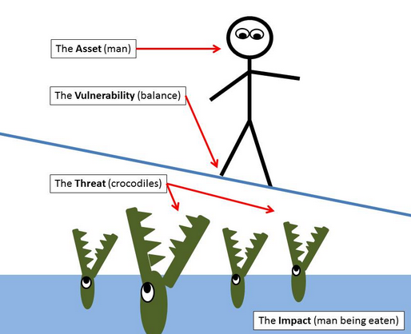
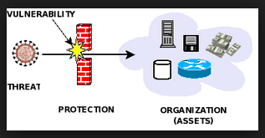

Slide 11
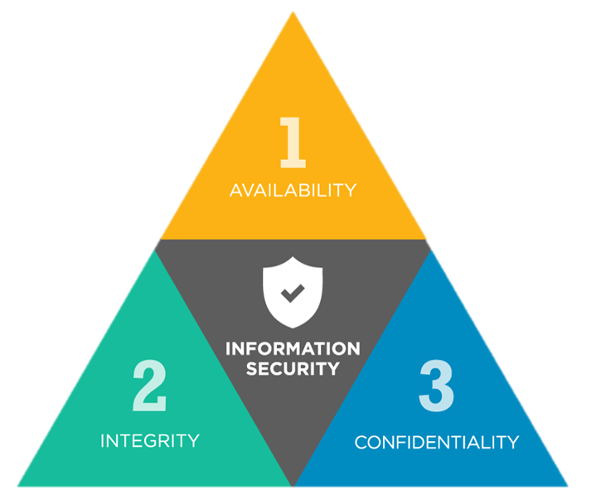
Key concepts of Information Security
CIA triad, is a model designed
to guide policies for information
security within an organization.

Slide 12
Key concepts of Information Security
Confidentiality :
Confidentiality of information ensures that only those with sufficient privileges may access certain information.
To protect the confidentiality of information, a number of measures may be used, including:
Information classification
Secure document storage
Application of general security policies
Education of information custodians and end users

Slide 13
Key concepts of Information Security
Integrity
Integrity is the quality or state of being whole, complete, and uncorrupted.
The integrity of information is threatened when it is exposed to corruption, damage, destruction, or other disruption of its authentic state.
Corruption can occur while information is being compiled, stored, or transmitted.

Slide 14
Key concepts of Information Security
Availability
Availability is making information accessible to user access without interference or obstruction in the required format.
A user in this definition may be either a person or another computer system.
Availability means availability to authorized users.

Slide 15
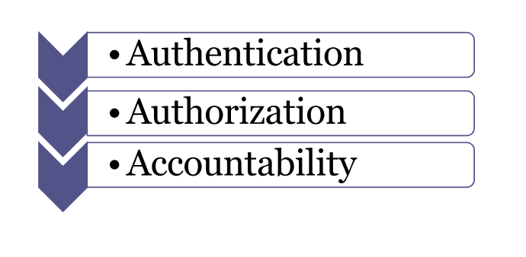
Key concepts of Information Security

Slide 16

Key concepts of Information Security
Authentication
Authentication occurs when a control provides proof that a user possesses the identity that he or she claims.

Slide 17

Key concepts of Information Security
Authorization
After the identity of a user is authenticated, a process called authorization provides assurance that the user (whether a person or a computer) has been specifically and explicitly authorized by the proper authority to access, update, or delete the contents of an information asset.

Slide 18

Key concepts of Information Security
Accountability
The characteristic of accountability exists when a control provides assurance that every activity undertaken can be attributed to a named person or automated process.

Slide 19
The security violations – Categories
Breach on Data Confidentiality
  Tapping / spoofing
Breach on Data Integrity
  Modification: salami attack -> little bits add up
    E.g: have off” the fractions of cents after interest calculations
Breach on Data Availability
  Dos attack

Slide 20
  The security violations - Methods
    Replay attack
      Gathering information
      Message is transmitted over the network
        Network tap
        ARP poisoning
        Malwares

Slide 21
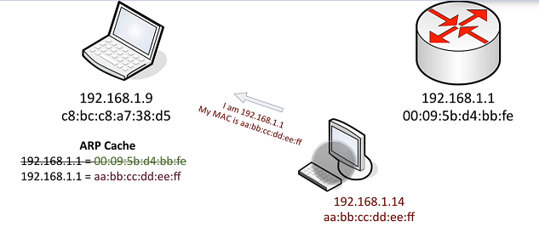
The security violations - Methods
    Man-in-the-middle attack
      Redirects your traffic
      ARP poisoning
      Cain and Able

Slide 22
The security violations - Methods
    Session hijacking
      Used for tracking and session management
      Privacy risk
      Wireshark, modify headers, tamper data
    Masquerading (breach authentication)

Slide 23
Types of Malicious Code
Bacterium - A specialized form of virus which does not attach to a specific file. Usage obscure.
Logic bomb - Malicious [program] logic that activates when specified conditions are met. Usually intended to cause denial of service or otherwise damage system resources.
Trapdoor - A hidden computer flaw known to an intruder, or a hidden computer mechanism (usually software) installed by an intruder, who can activate the trap door to gain access to the computer without being blocked by security services or mechanisms.
Trojan horse - A computer program that appears to have a useful function, but also has a hidden and potentially malicious function that evades security mechanisms, sometimes by exploiting legitimate authorizations of a system entity that invokes the program.
Virus - A hidden, self-replicating section of computer software, usually malicious logic, that propagates by infecting (i.e., inserting a copy of itself into and becoming part of) another program. A virus cannot run by itself; it requires that its host program be run to make the virus active.
Worm - A computer program that can run independently, can propagate a complete working version of itself onto other hosts on a network, and may consume computer resources destructively.
More types of malicious code exist… [cf. http://www.ietf.org/rfc/rfc2828.txt]
Notes:
25
FIRST, you must begin to think of malicious logic as more than just a virus. Some of this malicious code act as delivery agents. Others act as triggers.
Regardless of their method of use, operational capability or intent - -
All malicious code can be evaluated in the context of three principles:
Understanding these principle allows for successful countermeasures which we will touch on later for each type of code.
- Delivery Method or System Access
- Trigger or Initiation Mechanism
- Payload or effect on system

Slide 24
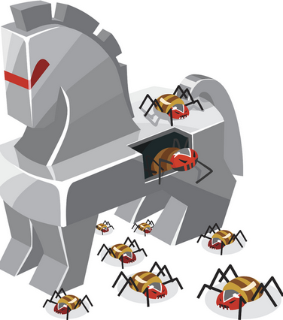
Program threats
Trojan horse
  Software that pretends to be something else
  Main purpose is the get into the system
  Code segment that misuses its environment
  Exploits mechanisms for allowing programs written by
  users to be executed by other users
  Spyware, pop-up browser windows, covert channels
  Bakasoftware (antivirus xp 2008 and spyware project 2009)

Slide 25
Program threats
Trap Door
  Specific user identifier or password that circumvents normal security procedures
  Could be included in a compiler
  No need for authentication
  Often place by malware

Slide 26
Program threats
  Logic Bomb
    Program that initiates a security incident under certain circumstances
    Need to wait for predefined event (time event, date event, user event)
    Difficult to identify
    Fannie mae logic bomb
  Stack and Buffer Overflow
    Exploits a bug in a program (overflow either the stack or memory buffers)
    Not a simple exploit
    Developers needs to perform bounds checks

Slide 27
Program threats
  Program with buffer overflow condition
      #include <stdio.h>
      #define BUFFER SIZE 256
      int main(int argc, char *argv[])
      {
      char buffer[BUFFER SIZE];
      if (argc < 2)
      return -1;
      else {
      strcpy(buffer,argv[1]);
      return 0;
      }
    }

Slide 28
Program threats
  Viruses
    Malware that can reproduce itself
    Code fragment embedded in legitimate program (execution required)
    Very specific to CPU architecture, operating system, applications
    Reproduces through file systems or networks
    Usually borne via email or as a macro
    Visual Basic Macro to reformat hard drive
        Sub AutoOpen()
        Dim oFS
        Set oFS = CreateObject(’’Scripting.FileSystemObject’’)
        vs = Shell(’’c:command.com /k format c:’’,vbHide)
        End Sub

Slide 29
Program threats
  Viruses
    Virus dropper inserts virus onto the system
    Many categories of viruses, literally many thousands of viruses
      File
      Boot (mebroot)
      Macro (Melissa virus)
      Source code
      Multipartite (depends on OS) (codeRED)
      Polymorphic (encrypted and changes coding)
      Encrypted
      Stealth (attack the OS processes)
      Tunneling

Slide 30
Program threats
  Worms
  – use spawn mechanism; standalone program
  uses network as transmission medium
    Internet worm
      Exploited UNIX networking features (remote access) and bugs in finger and send mail programs (iloveyou worm)
      Grappling hook program uploaded main worm program

Slide 31
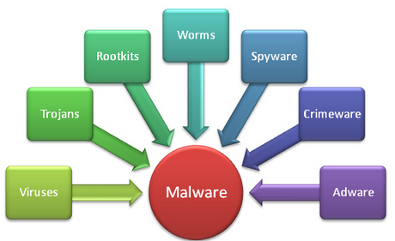
Malware
Malware
  Malware is an umbrella term used to refer to a variety of forms of hostile or intrusive software, including computer viruses, worms, Trojan horses, ransomware, spyware, adware, scareware, and other malicious programs. It can take the form of executable code, scripts, active content, and other software.

Slide 32
System and Network Threats
  Port scanning
    Automated attempt to connect to a range of ports on one or a range of IP addresses
    Poke around to see what’s open and identify system
    NMAP
  Denial of Service
    Overload the targeted computer preventing it from doing any useful work (force a service to fail)
    Distributed denial-of-service (DDOS) come from multiple sites at once
    Core flood botnet

Slide 33
Q&A ?

Slide 34
Security in Operating System
Security must occur at four levels to be effective:
  Physical
    devices
  Human
    Avoid social engineering, phishing
  Operating System
  Network
Security is as weak as the weakest link in the chain

Slide 35
Security measure
IPS (intrusion prevention systems)
  Monitors a single host for suspicious activity by analyzing events within the host
  Host based firewall
  Network based firewall
IDS (intrusion detection systems)
  Capable of monitoring and analyzing internals of computer system as well as network
  it is not designed to block attacks.

Slide 36
Host Based Firewall
Host based firewall
  A host-based firewall is a piece of software running on a single host that can restrict incoming and outgoing network activity for that host only. They can prevent a host from becoming infected and stop infected hosts from spreading malware to other hosts.
  Server or clients are equipped with default firewalling tools.
  Used by individuals

Slide 37
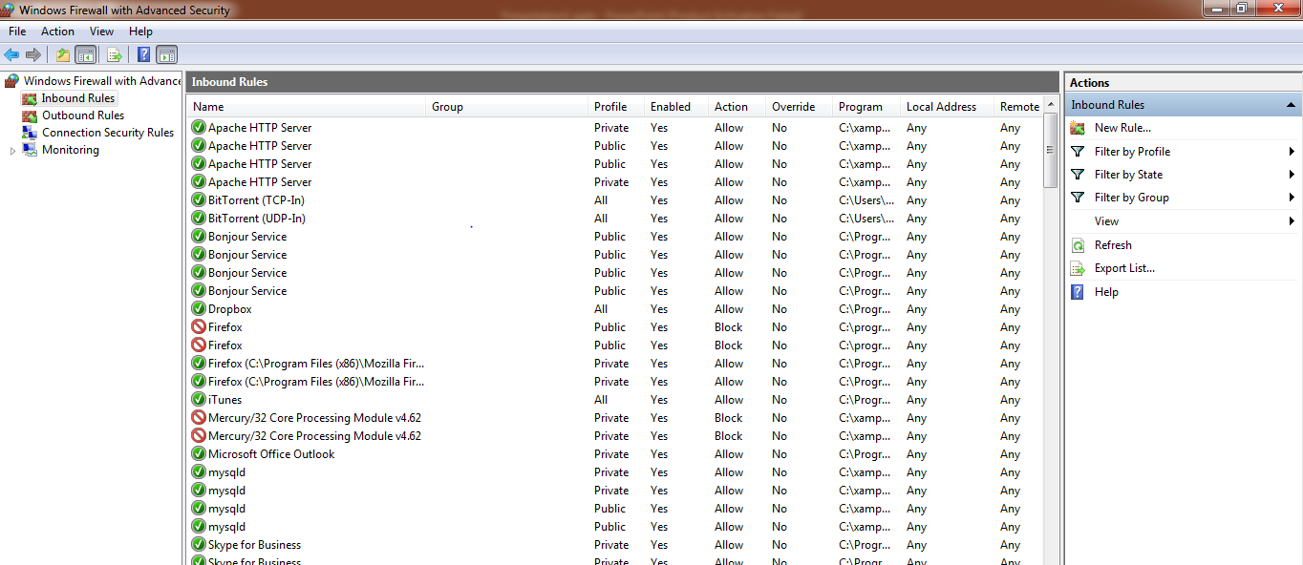
Host Based Firewall
  Example: Microsoft (Windows firewall), Linux (Iptables, IPFW, etc)

Slide 38
Network based firewall
Built into the infrastructure of the cloud (Amazon’s firewall in AWS environment)
virtual firewalls services such as those offered by cisco, check point.
Used in organizations

Slide 39
Q&A ?

Slide 40
Summary
In this lecture we discussed
  Key concepts security in operating systems
  Program threats
  System and network threats
  Host based firewalls and Network based firewalls

Slide 41


